Slide 1
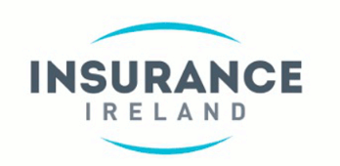
Breakfast Briefing - Talent in Insurance 2015
February 10th - 2016

Slide 2
Today’s Agenda 1. Introductions 2. Talent in Insurance 2015 Survey (Global and Irish) 3. Insights from the Banking Sector (Questions and Answers) 4. Waves of Disruption 5. Talent in Insurance Breakout Session 6. Next Steps & Event Close
Insurance Ireland – Deloitte Strategic Alliance Partnership
1

Slide 3
Talent in Insurance Introductions Donal Lehane (Consulting Insurance Partner, Deloitte) Kevin Thompson (CEO, Insurance Ireland)

Slide 4
Talent in Insurance Survey 2015 Global Focus Fiona Kenefick (Human Capital, Deloitte)

Slide 5
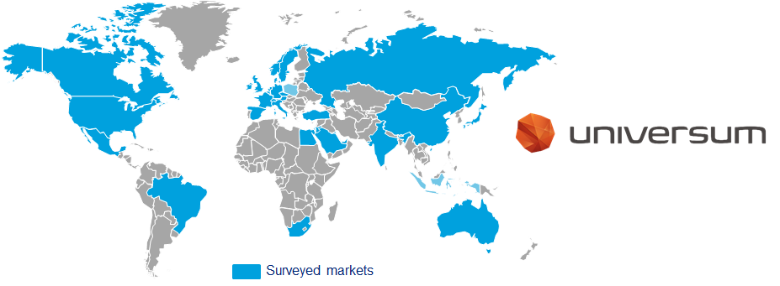
Talent in Insurance 2015 Global Scope and Methodology
Insurance Ireland – Deloitte Strategic Alliance Partnership
Markets surveyed for Deloitte Talent in Insurance Survey 2015
211,451 business students from 2,086 universities and institutions of higher education
Sample Questions
Choose the employers you most want to work for, your five ‘ideal’ employers?
Which of the following (40) attributes do you associate with your chosen employer?
Of a list of 9 career goals, which are most important to you?
Source: Universum Talent Survey 2015; Deloitte Analysis
© 2015 Deloitte
Notes:
Focus on aspirations and expectations of 60,429 “banking-inclined” students who name a bank among five “ideal employers” and 6,392 “insurance-inclined” students who name an insurer among five “ideal employers”.
For this survey, business students are defined as students of business-related subjects. “Insurance-inclined students” are a subset who put at least one insurer in their top five “ideal employers”.

Slide 6
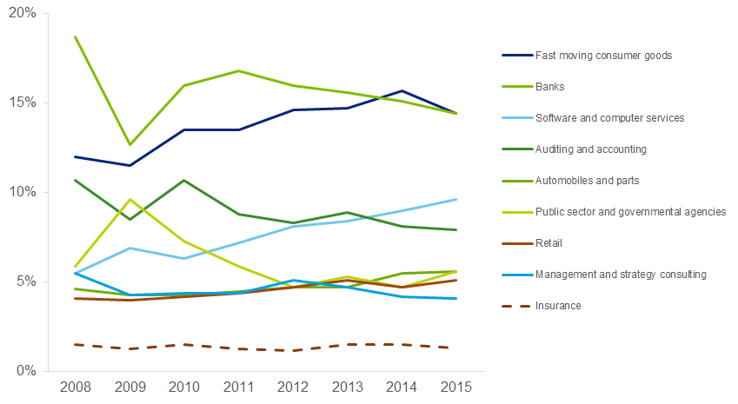
Insurance continues to trail in the popularity stakes, languishing at 18th out of 30 sectors, while FMCG and Banks continue to power ahead …
Talent in Insurance 2015 Global Industry Popularity
Insurance Ireland – Deloitte Strategic Alliance Partnership
Figure 1. Top eight career destinations for business students plus insurance, globally (2008-2015)
Source: Universum Talent Survey 2015; Deloitte Analysis
© 2015 Deloitte

Slide 7
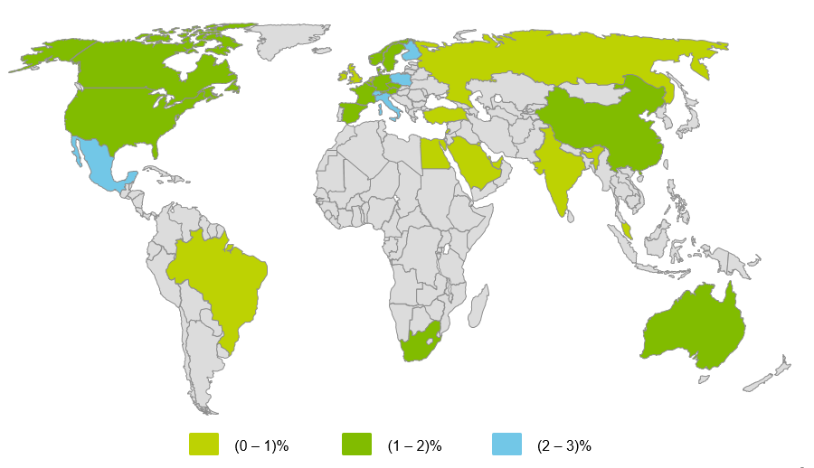
Talent in Insurance 2015 Global The ‘Unpopularity’ is Widespread
Insurance Ireland – Deloitte Strategic Alliance Partnership
Figure 2. Popularity of insurance among business students, globally, 2015
If only the map was ‘#Google-ified’ - it would paint a different picture
Google continues to be the single most popular employer by far, being chosen most often as an “ideal employer” in 17 out of 29 markets surveyed
Source: Universum Talent Survey 2015; Deloitte Analysis
© 2015 Deloitte

Slide 8
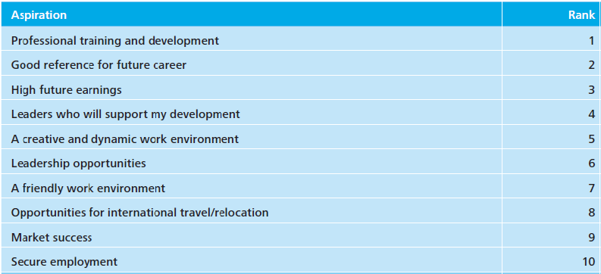
Talent in Insurance 2015 Global Students Aspirations - Overall
Insurance Ireland – Deloitte Strategic Alliance Partnership
Aspirations = a hope or ambition of achieving something
Our table highlights the top ten ranked aspirations of business students globally, 2015
Business students are focused on developing themselves - three out of the top five aspirations relate to development
Figure 3. Top ten aspirations for business student average, globally, 2015
Source: Universum Talent Survey 2015; Deloitte Analysis
© 2015 Deloitte

Slide 9
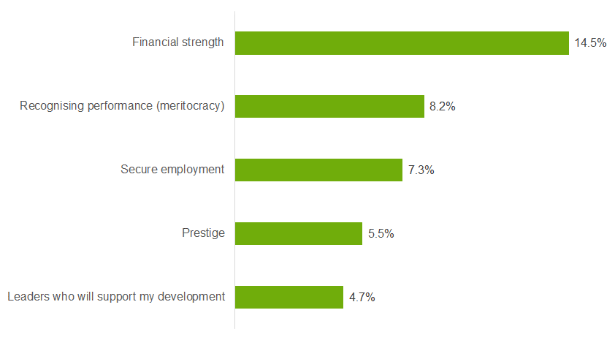
Those who want to work in insurance appear conservative, based on their high hopes to work for financially strong, secure and prestigious employers
Talent in Insurance 2015 Global Students Aspirations - Insurance
Insurance Ireland – Deloitte Strategic Alliance Partnership
Figure 4. Top five differences in aspiration between insurance-inclined students vs. business student average, globally, 2015
Source: Universum Talent Survey 2015; Deloitte Analysis
© 2015 Deloitte

Slide 10
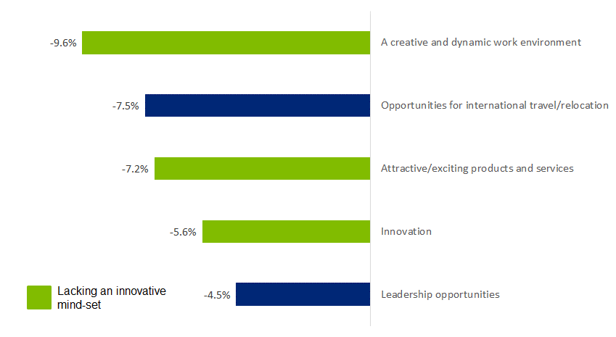
Three of the five lowest aspirations (green bars) of insurance-inclined students compared to business students as a whole relate to innovation
Talent in Insurance 2015 Global Students Aspirations - Insurance
Insurance Ireland – Deloitte Strategic Alliance Partnership
Figure 5. Bottom five aspirations of insurance-inclined students vs. average, globally, 2015
Source: Universum Talent Survey 2015; Deloitte Analysis
© 2015 Deloitte

Slide 11
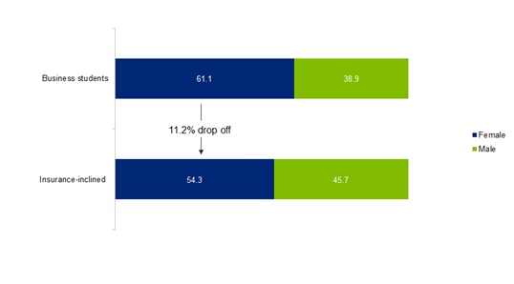
Talent in Insurance 2015 Global Insurance Students ‘Gender Diversity’
Insurance Ireland – Deloitte Strategic Alliance Partnership
Women continue to be under-represented among insurance-inclined students
6.8 % drop off
Figure 6. Gender breakdown among business students, globally, 2015
Source: Universum Talent Survey 2015; Deloitte Analysis.
© 2015 Deloitte

Slide 12
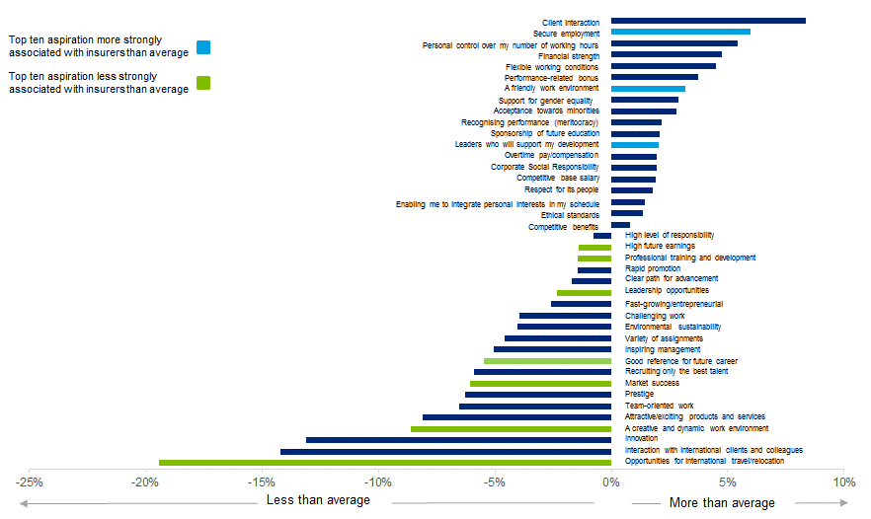
Insurers are less strongly associated than average employer with seven out of top ten aspirations ….. However
Talent in Insurance 2015 Global Key (Mis)Perceptions?
Insurance Ireland – Deloitte Strategic Alliance Partnership
Figure 7. How strongly insurers are associated with 40 key employer attributes compared to the average employer, globally, 2015
Source: Universum Talent Survey 2015; Deloitte Analysis
© 2015 Deloitte

Slide 13
Talent in Insurance Survey 2015 Ireland in Focus

Slide 14
“Security and Stability dominate career goals”

Slide 15
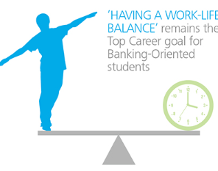
Insurance Ireland – Deloitte Strategic Alliance Partnership
Talent in Insurance 2015 Ireland
Ireland in Focus – Key Findings
Insurance is less popular in Ireland - The popularity of insurance as a career choice for business students remains the 5th lowest among the 21 EMEA markets surveyed - the lowest in Western Europe.
Software and FMCG are the most popular sectors – Although dropping slightly from 2014, the software and fast-moving consumer goods top the polls as the most popular industries among Irish business students.
The Google Effect – Although Ireland is the 7th largest provider of financial services in the EU, Google, Apple and Facebook reign as employers of choice for Irish graduates
Paddy Power is gaining ground – Coming a close second to Google as the employer of choice for Irish insurance inclined students. The efforts of those in the ‘Power Tower’ are gaining traction with Irish graduates.
Gender (Im)balance – Female Irish business students are less likely than their male counterparts to express an interest in working in insurance with a drop off rate of 15.7% Only Switzerland accounted for a lower inclination in their female cohort surveyed.
Security and Work Life Balance – Security/stability dominate the top career goal for Irish insurance inclined graduates rising with work life balance coming in a close second.
Not motivated by money? - Irish insurance inclined students say they are more concerned with secure employment and development opportunities rather than pay.
Source: Universum Talent Survey 2015; Deloitte Analysis.
Private and Confidential: Deloitte Ireland
© 2015 Deloitte

Slide 16
Insurance Ireland – Deloitte Strategic Alliance Partnership
Talent in Insurance 2015 Ireland
Where do Irish Business Students want to work ?
In Ireland, the software sector tops the popularity poll while in other EMEA markets it is typically in 3rd, 4th or 5th place, behind banking and FMCG companies. Interestingly, Banks remain the sector of choice for Irish students.
Industry Sectors
While Google is top choice in eight other EMEA countries, Ireland continues to have the highest number of tech companies featured in the “ideal employer” list with Google, Apple and Facebook being ranked in the top 3. Disney and Coca-Cola close out the top five.
Employers
All
By comparison, after Google, the remaining “ideal employers” for insurance inclined students includes Paddy Power, Bank of Ireland, Goldman Sachs with Professional Services Firms closing the list is.
Employers
Ireland
Source: Universum Talent Survey 2015; Deloitte Analysis.
Private and Confidential: Deloitte Ireland
Private and Confidential: Deloitte Ireland
© 2015 Deloitte
Notes:
Notes
Industry Sectors
FMCG, Banking and Software Services are the three most popular industry sectors both globally and in Ireland
FMCG and Banking are both ranked in 2nd and 3rd place respectively by Irish Business Students.
Employers
Globally, Google is the most popular employer in 15 out of 28 markets surveyed;

Slide 17
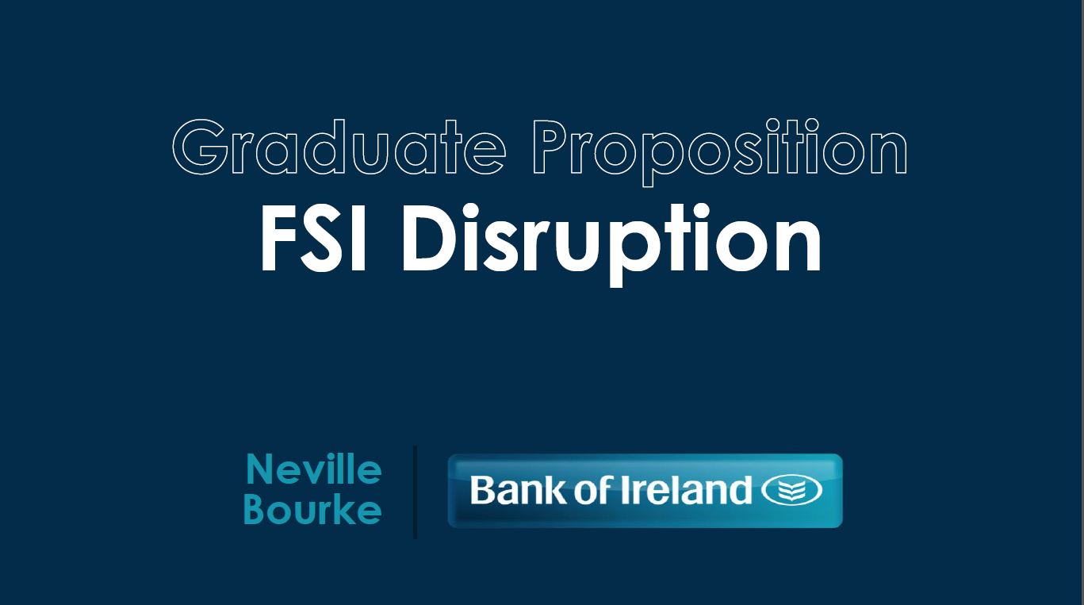
Insights from the Banking Sector Neville Bourke (HR Director, BOI Retail)

Slide 18
Questions
Insurance Ireland – Deloitte Strategic Alliance Partnership
Talent in Insurance 2015
Insights from the Banking Sector
Answers
Private and Confidential: Deloitte Ireland
Private and Confidential: Deloitte Ireland
© 2015 Deloitte
Notes:
Notes
Industry Sectors
FMCG, Banking and Software Services are the three most popular industry sectors both globally and in Ireland
FMCG and Banking are both ranked in 2nd and 3rd place respectively by Irish Business Students.
Employers
Globally, Google is the most popular employer in 15 out of 28 markets surveyed;

Slide 19
Waves of Disruption The Future of Ireland’s Financial Services Sector John Kilbride (Director, Deloitte)

Slide 20
Talent in Insurance 2015 Event Close Donal Lehane (Deloitte)

